Slide 1
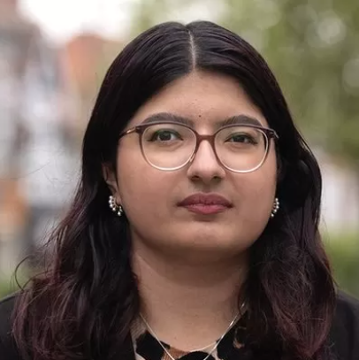
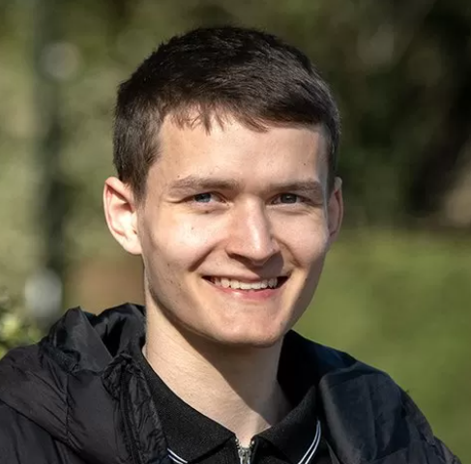

Understanding local elections
“Many children are not taught about politics at school, let alone what councils do” Tina Bhartwas, Labour Councillor, 21 yrs
Making maths sense
“…It's really important that young voices are heard because a lot of the things the council does affects young people” Andrew Rushton, LibDem candidate, 21 yrs
The following slide contains extracts from a BBC News article about local elections of councillors in England.
What do the statistics tell you about the age of councillors?
"You don't do it for the money, you do it because you care about the community. But sometimes [money] can be a barrier” Joe Porter, Conservative Councillor and full time emergency service worker, 26 yrs
Notes:
Tina Bhartwas, Hertfordshire County Councillor, Labour
Andrew Rushton, LibDem candidate Lichfield
Joe Porter, Staffordshire Moorlands District Councillor, Conservative

Slide 2
Local elections 2023: Young councillors 'need seat at table'
When Tina Bhartwas was elected two years ago at the age of 19, she was the youngest ever councillor on Hertfordshire County Council.
Across England, the average age of councillors is around 60 - a figure that has barely changed in the last decade - and only 16% are under 45, according to the Local Government Association (LGA).
Councillors spend an average of 22 hours a week on their role.
They are not paid a salary. Instead they get an allowance, which is set by each council and varies significantly across England.
On average, it is about £7,000 a year.
What would your priority be if you were elected onto your local council?
Discuss: what do you know about local councils? Why are older people more likely to stand for council? Why might it be considered important for young people to be represented on the council?
Notes:
Retrieved from Local elections 2023: Young councillors 'need seat at table' - BBC News 02/05/23
Local councils are responsible for many public services, including:
providing care for elderly and disabled people
schools
fixing potholes on some roads
collecting rubbish
Etc
This slide encourages students to interpret data and explain maths terminology (average, percentages, salary, allowance)

Slide 3

If you would like more topical resources….
Hide this slide!
… or other support in embedding maths and English in curriculum delivery,
contact Sam Woodland pickMEconsulting@gmail.com, 07717 855443
Plus, please give me feedback – did you find this helpful? You can also find me on Linkedin.

